Slide 1


PREDICTIVE HEALTH ANALYSIS
FOR MULTIPLE DISEASES USING ENSEMBLE LEARNING

Slide 2

Introduction
In this project, an predictive health analysis model for multiple diseases using ensemble learning is developed.
The model used : Hyperparameter tuned Support vector classifier, Random forest, Naive Bayes, Gradient boosting and Decision tree .
This project will focus on the Disease-Symptom dataset.
The objective of this project is to predict symptom severity of multiple diseases.
Comparative study of the algorithms using the same dataset.
SVM with hypertuning has a score of 99.49 % outperforms other algorithms.

Slide 3
There were many models for single disease but not much for multiple disease.
Datasets for single diseases are are publicly available
Predictive analysis is a very
useful tool when it comes to the field of medical decision-making.
Mind Map
An ensemble learning technique is to integrate different machine learning models to assist decrease bias and variance.
The rate of mortality has
Comparative study of various algorithms helps us for better
increased exponentially due to
not predicting the severity of the disease in its early stages.
prediction and symptom severity
helps to determine stage of disease.

Slide 4
Literature review
2. An empirical model to predict the diabetic positive using a stacked ensemble learning approach
4. Ensemble learning classification for medical diagnosis
1. Diabot: A Predictive Medical Chatbot using Ensemble Learning
3. PREDICTING MEDICATION ADHERENCE USING ENSEMBLE LEARNING AND DEEP LEARNING MODELS WITH LARGE SCALE HEALTHCARE DATA

Slide 5
Literature review
5. Development of Disease Prediction Model Based on Ensemble Learning Approach for Diabetes and Hypertension
6. Automatic Diabetes Prediction Using Tree Based Ensemble Learners
3. A dynamic, ensemble learning approach to forecast dengue fever epidemic years in Brazil using weather and population susceptibility cycles

Slide 6



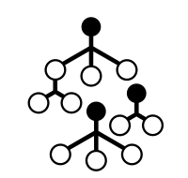
Tools and Technology
Tools and technology
-Language: Python
-Scikit Learn (library for ensemble learning)
-Matplotlib
Platform
-Google collab
Dataset
-Disease symptom dataset

Slide 7
Methodology
The main aim of this paper is to conduct a predictive analysis of multiple diseases using the ensemble learning approach.
For the same purpose, this study has utilized a dataset where multiple different diseases are considered.
Every symptom in the dataset is assigned a weight which helps to determine the severity of the symptom
Further helps to determine the stage of severity of a given particular disease.
This paper aims to make a predictive analysis on the basis of the output. Additionally, compare various models along with their accuracy to generate the best possible result.

Slide 8









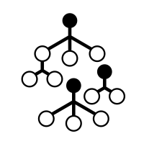
Project flow diagram :
Importing libraries and dataset
data pre processing
Ranking the symptom
splitting the dataset
Training
Comparison of algos
Predictions
Mean accuracy, standard
deviation
Calculating Confusion matrix
ensembling algos:
Random forest, SVM, etc

Slide 9
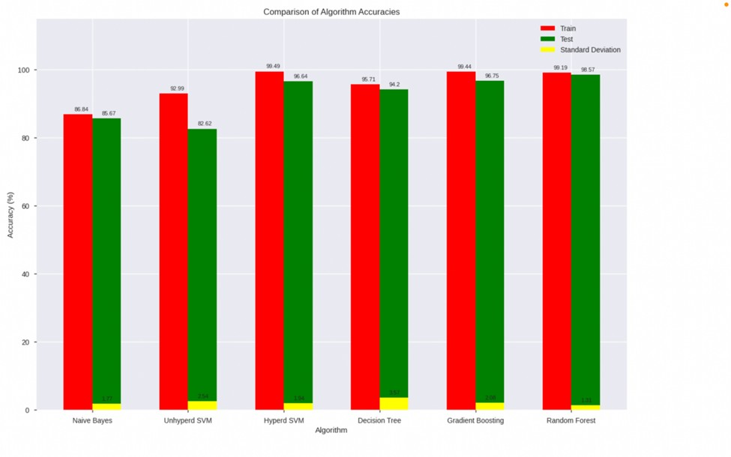
Results :
Considering the parameters random forest, Gradient boosting and SVM with hyper parameter tuning outperforms all the other algorithms with a score of 99.58 percentage.
Figure 1: Comparison of training accuracy, testing accuracy and standard deviation of all the algorithms

Slide 10
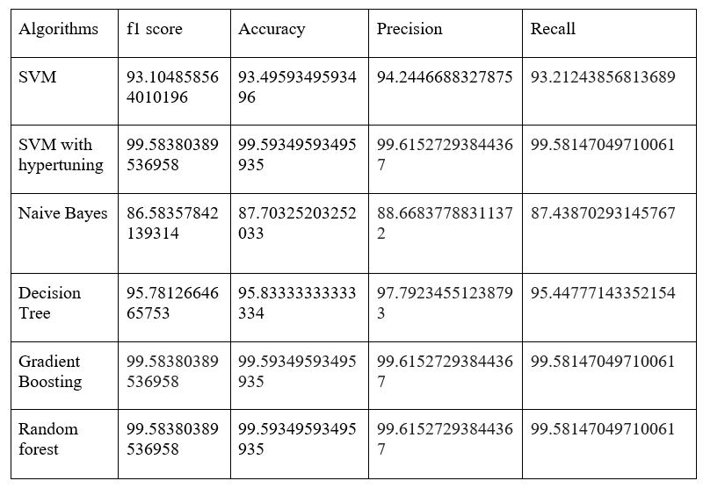
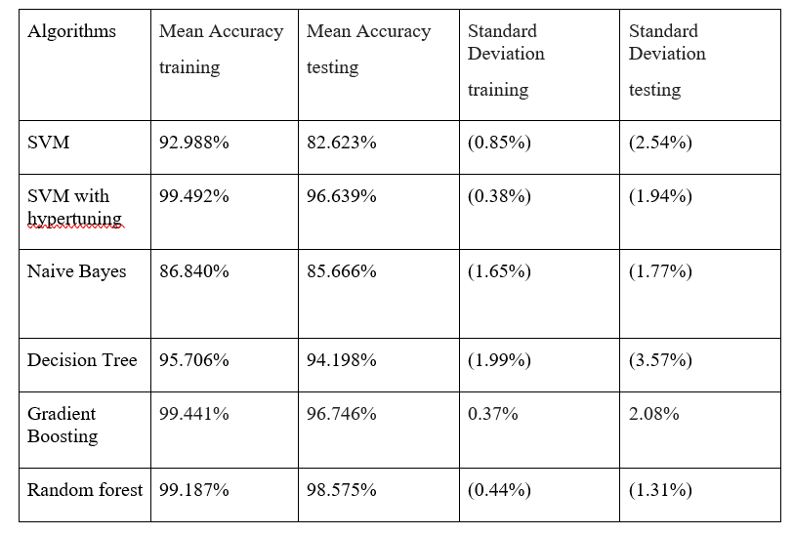
Results :
Table 1: F1 score, accuracy, recall and precision values of all the algorithms
Table 2: Mean accuracy fortraining and testing dataset as well asstandard deviation for training and testing dataset values of all the algorithms

Slide 11

Conclusion
Considering the parameters random forest,
Gradient boosting and SVM with hyper
parameter tuning outperforms all the other algorithms with a score of 99 . 58 percentage.
As we can see these results are not very
accurate and seem to have the same values for the same parameters for different
algorithms one can' t really make a hard conclusion.
To overcome this barrier model performance was calculated using 10 - Fold Cross- Validation. This helps retain information even for the data that was unused during training.
Multiple disease prediction i s done considering symptoms

Slide 12
References
[1]. World Health Organization. (2018). Noncommunicable Diseases. [Online].
Available:https://www.who.int/en/news-room/fact-sheets/detail/noncommunicable-diseases [2]. D. H. Wolpert, ‘‘Stacked generalization,’’ Neural Netw., vol. 5, no. 2, pp. 241–259, Jan. 1992. [3]. L. Breiman, ‘‘Stacked regressions,’’ Mach. Learn., vol. 24, no. 1, pp. 49–64, Jul. 1996.
[4]. Basma Boukenze, Hajar Mousannif, “Predictive Analytics in Healthcare System Using Data Mining
Techniques” ,Conference: The Fourth International Conference on Database and Data Mining, April 2016
[5]. Seyedan, M., Mafakheri, F. Predictive big data analytics for supply chain demand forecasting: methods,
applications, and research opportunities. J Big Data 7, 53 (2020). https://doi.org/10.1186/s40537-020-00329-2 [6]. Bali, M., Mohanty, S., Chatterjee, S., Sarma, M. and Puravankara, R., 2019. Diabot: a predictive medical
chatbot using ensemble learning. Int. J. of Recent Technol. and Eng., pp.2277-3878.
[7]. Fitriyani, N.L., Syafrudin, M., Alfian, G. and Rhee, J., 2019. Development of disease prediction model based on ensemble learning approach for diabetes and hypertension. IEEE Access, 7, pp.144777-144789.] [8]. Gu, Y., Zalkikar, A., Liu, M., Kelly, L., Hall, A., Daly, K. and Ward, T., 2021. Predicting medication
adherence using ensemble learning and deep learning models with large-scale healthcare data. Scientific Reports, 11(1), pp.1-13.

Slide 13
References
[9]. Lohumi, P., Garg, S., Singh, T.P. and Gopal, M., 2020, October. Ensemble learning classification for
medical diagnosis. In 2020 5th International Conference on Computing, Communication and Security (ICCCS) (pp. 1-5). IEEE.
[10]. Sivashankari, R., Sudha, M., Hasan, M.K., Saeed, R.A., Alsuhibany, S.A. and Abdel-Khalek, S., 2021. An Empirical Model to Predict the Diabetic Positive Using Stacked Ensemble Approach. Frontiers in Public
Health, 9.
[11]. McGough, S.F., Clemente, L., Kutz, J.N. and Santillana, M., 2021. A dynamic, ensemble learning approach to forecast dengue fever epidemic years in Brazil using weather and population susceptibility cycles. Journal of the Royal Society Interface, 18(179), p.20201006.
[12]. Pirjatullah, D. Kartini, D. T. Nugrahadi, Muliadi and A. Farmadi, "Hyperparameter Tuning using
GridsearchCV on The Comparison of The Activation Function of The ELM Method to The Classification of
Pneumonia in Toddlers," 2021 4th International Conference of Computer and Informatics Engineering (IC2IE), 2021, pp. 390-395, doi: 10.1109/IC2IE53219.2021.9649207.
[13]. Krishna Battula, “RESEARCH OF MACHINE LEARNING ALGORITHMS USING K-FOLD CROSS
VALIDATION” , International Journal of Engineering and Advanced Technology 8(6S):215-218 , March 2021.

